Slide 1
Alcohol Consumption, Alcohol-Related Harm, and Policy Responses in Countries
By: Willie Man, Leonel Rodriguez, Lauren Wendler

Slide 2
Tableau Visualizations

Slide 3
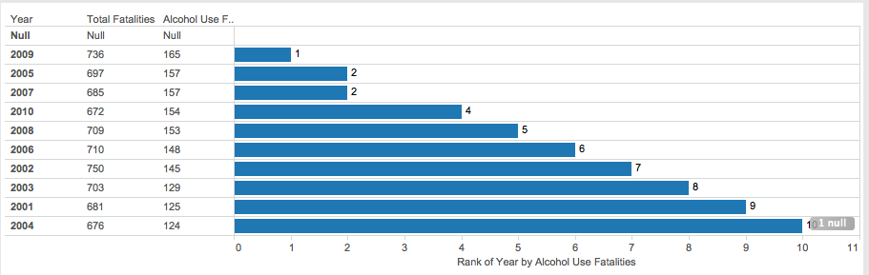
Rank of Year by Highest Alcohol Use Fatalities
Notes:
Based on year, ranked by Alcohol use fatalities from 1st to 10th highest.

Slide 4
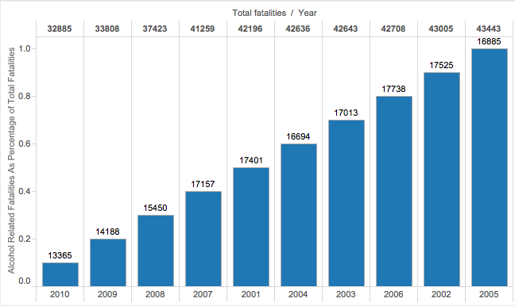
Rank of Alcohol Related Fatalities as Percentage of Total Fatalities
Notes:
Rank from 0-1
Lowest to highest total fatalities based on year
Adds alcohol related fatalities amount above

Slide 5
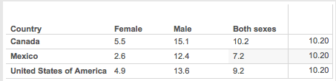
Highest Total Consumption of Both Females and Males
Notes:
Used nth value
Filtered by year 2008-2010, and filtered by just north american countries
Canada has both total consumption between men and women

Slide 6
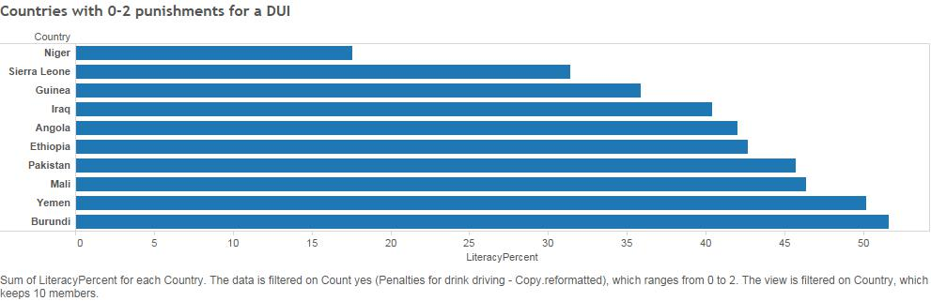
Are countries with low literacy rate more lenient with DUI’s?

Slide 7
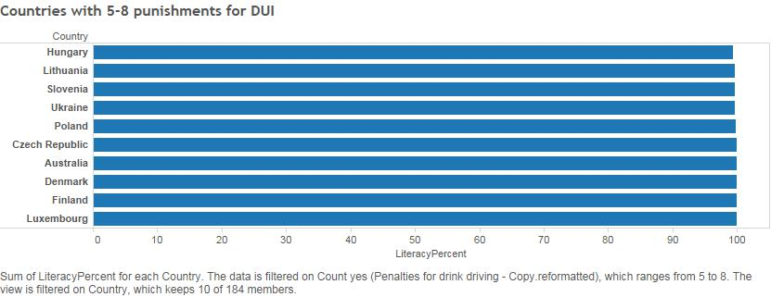
Compared to countries who employ multiple punishments for DUI’s.
Notes:
Note the perfect literacy rates

Slide 8
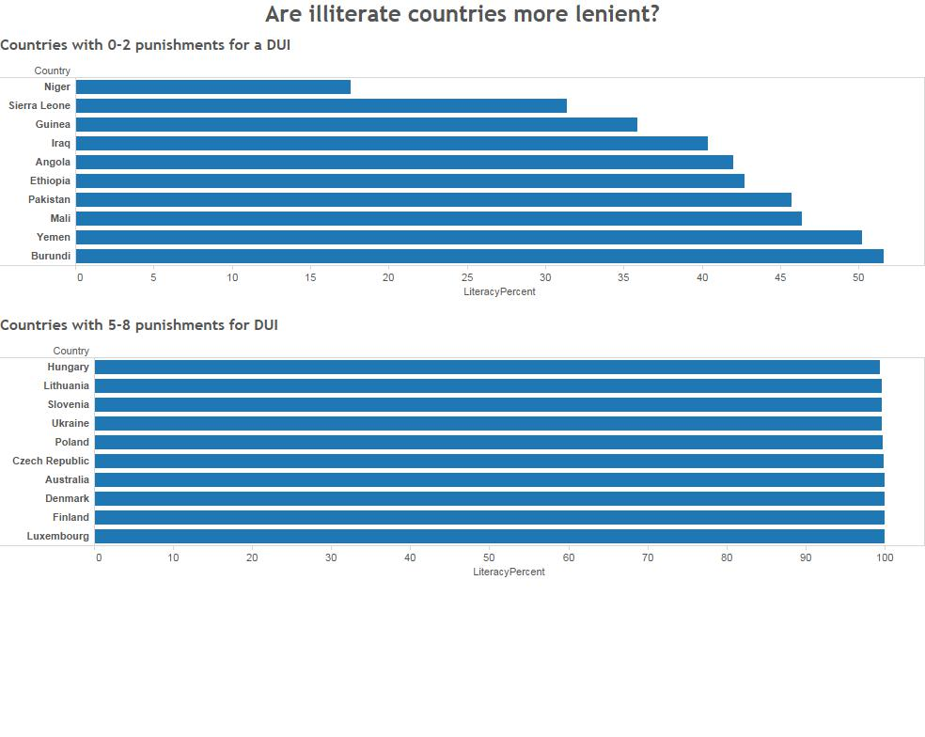
Notes:
In order to easier compare the graphs

Slide 9
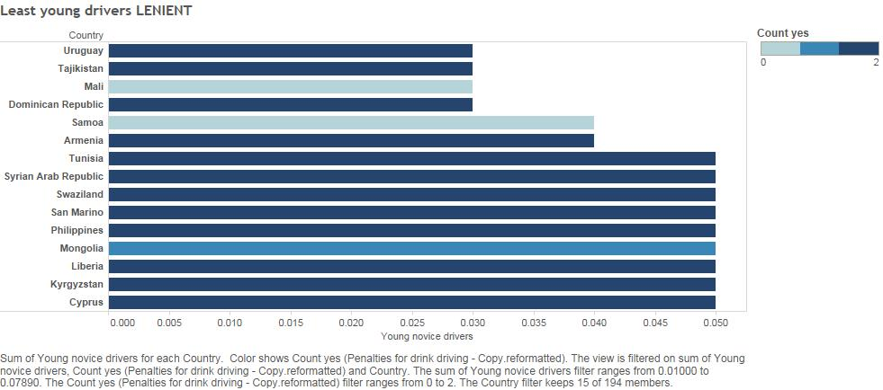
Are countries stance on drunk driving affected by the how many young drivers there are?

Slide 10
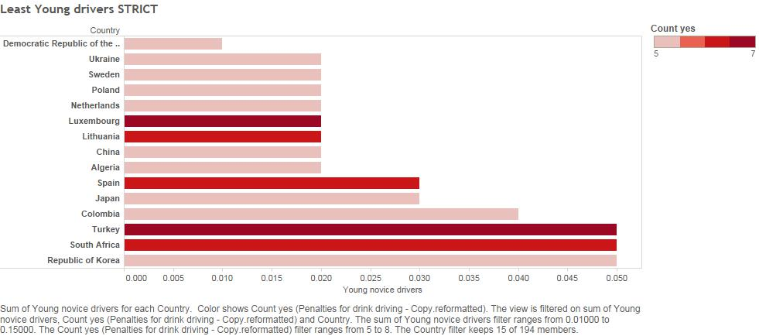
Notes:
These countries have a low percent of young drivers, regardless they employ a high if not all amount of punishments for being caught driving under the influence

Slide 11
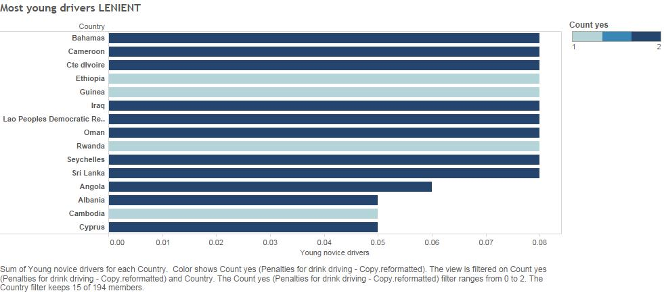
Notes:
I thought maybe that having a high percent of young drivers a country would be more strict in the amount of punishments for a DUI. Our data did not support this however.
Even though these countries had a lot of young drivers on the streets it did not affect the amount of punishments they'd administer.

Slide 12
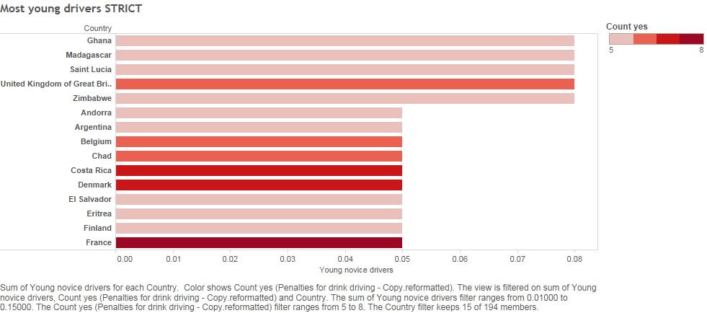
Notes:
These countries have the most amount of young drivers and take drunk driving very seriously employing many different punishments for drunk driving

Slide 13
R Studio Visualizations

Slide 14
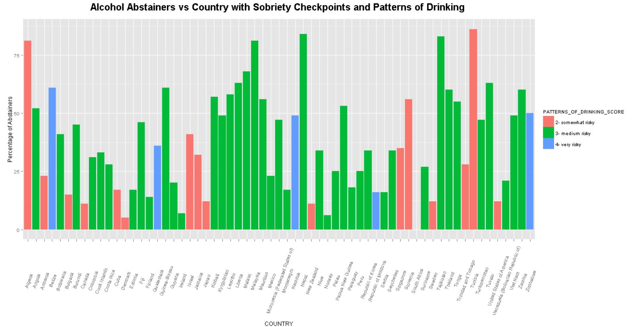
Notes:
Percent of abstainers in a country’s population, used data wrangling to find countries that use sobriety checkpoints. And it shows the patterns of drinking score of that country according to WHO. (Data Wrangling involved)

Slide 15
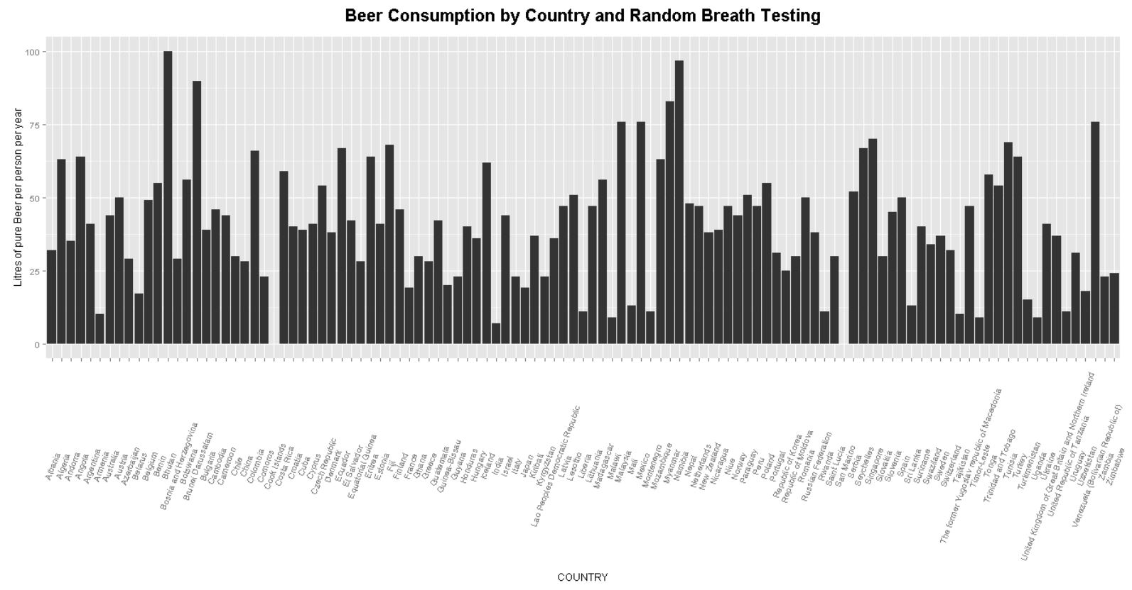
Notes:
A Histogram of Beer consumption for every country that uses Random Breath Testing (from Data Wrangling)

Slide 16
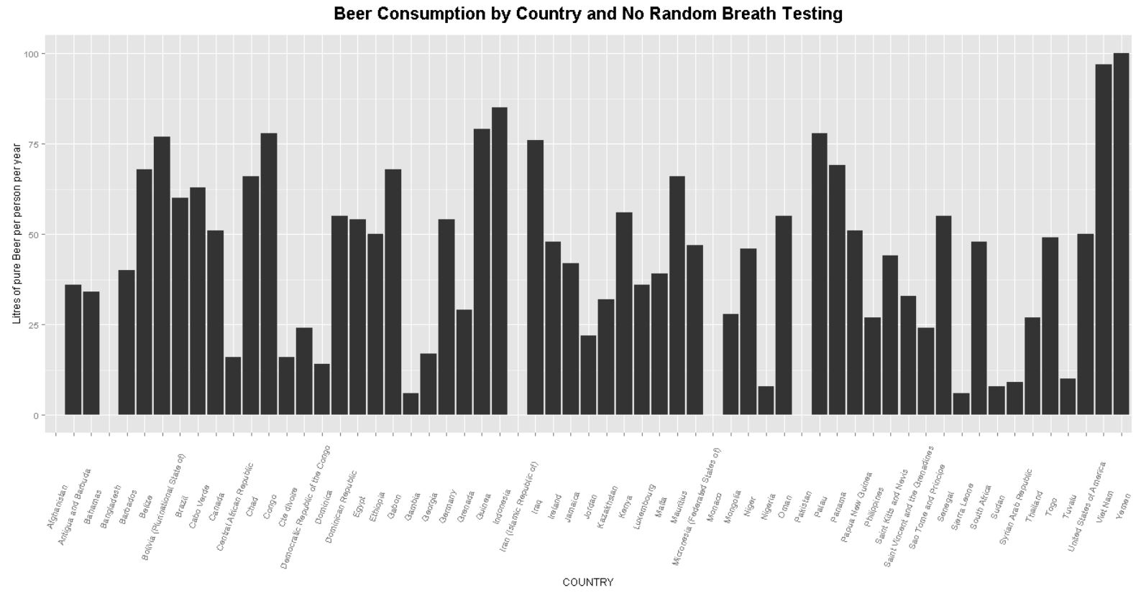
Notes:
A Histogram of Beer consumption for every country that does not use Random Breath Testing (from Data Wrangling)

Slide 17
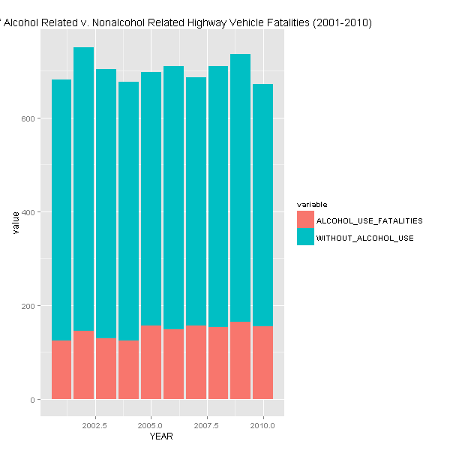
Notes:
A Bar Chart measuring total highway vehicle fatalities in US and then compares those that had alcohol involved.

Slide 18
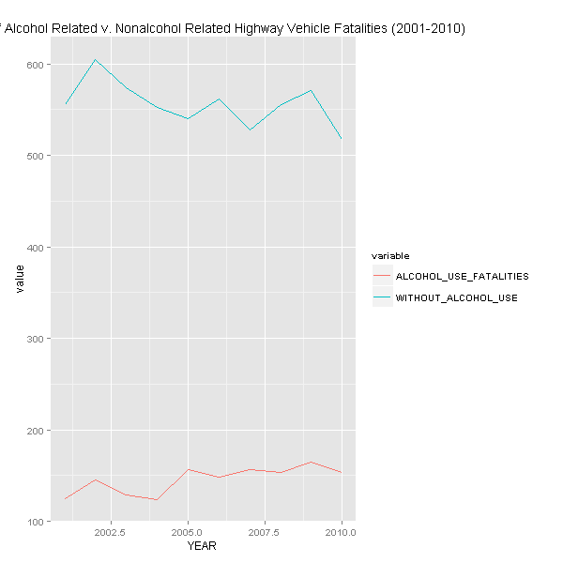
Notes:
Line graph representation of vehicle fatalities by year

Slide 19
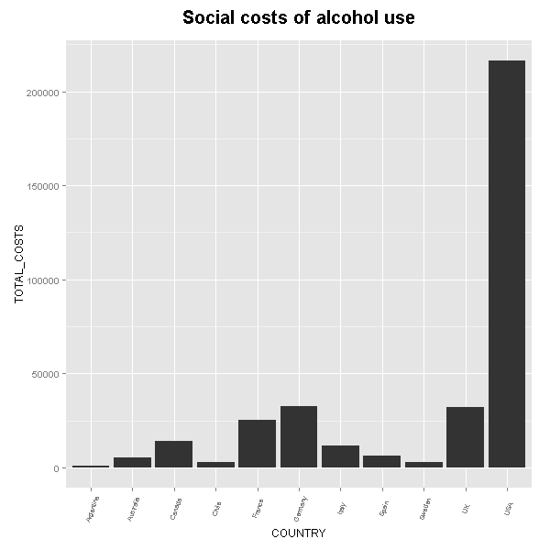
Notes:
Social costs of alcohol use in 11 countries

Slide 20
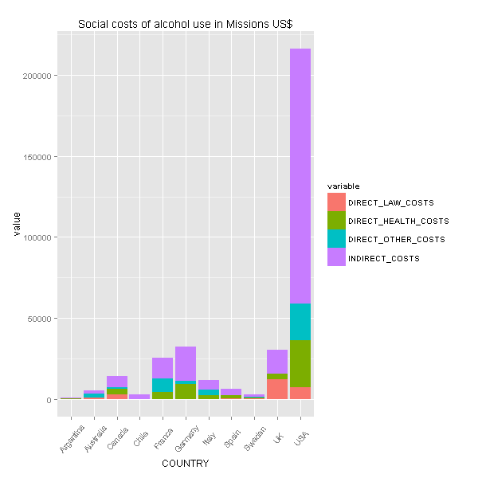
Notes:
A break down of total cost.. Typo (missions is supposed to million dollars)

Slide 21
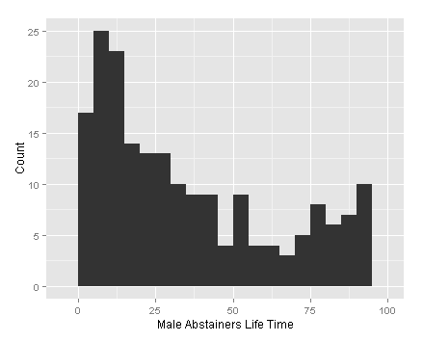
Notes:
Histogram of countries with various percentage of males that abstain from alcohol for life

Slide 22
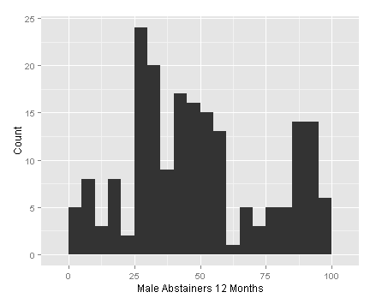
Notes:
Histogram of countries with various percentage of males that abstain from alcohol for 12 months

Slide 23
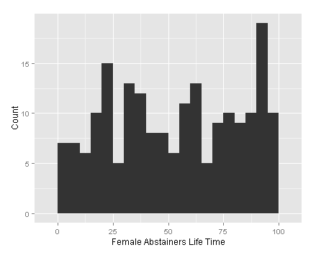
Notes:
Histogram of countries with various percentage of males that abstain from alcohol for life

Slide 24
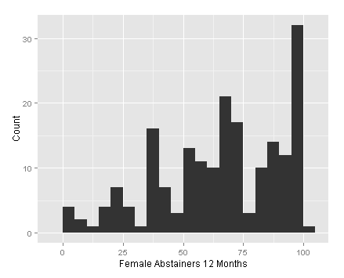
Notes:
Histogram of countries with various percentage of females that abstain from alcohol for 12 Months

Slide 25
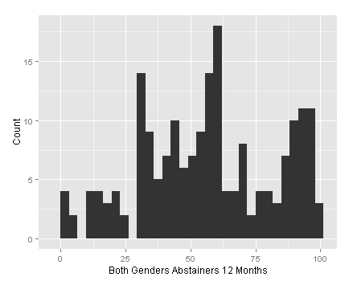
Notes:
Histogram of countries with various percentage of males and females that abstain from alcohol for 12 months

